Slide 1


Milestone 2
BY SRIHITHA K

Slide 2


CONTENTS
1. Title Slide
2. Review of Milestone 1 (The Old Way)
3. Goal of Milestone 2 – The Upgrade
4. The AI Extraction Engine (The Brain)
5. The Smartest Part – BERT Semantic Matching
6. Confidence Score – How Much Can We Trust the Result?
7. Demo – Input & UI
8. Demo – Skill Extraction with Confidence Scores
9. Demo – Semantic Relationships & Skill Intelligence
10. Conclusion & What’s Next
Bonus Tips for Presenting

Slide 3



1. Milestone 1 (The Old Way)
What we did in M1:
We read resumes (PDF, DOCX, TXT) using a clean and reusable file ingestion pipeline.
We used basic keyword matching to find skills like "Python", "Excel", etc.
Main Problem:
It was too simple.
• It found obvious skills,
• But
. missed context.
• Couldn't understand meaning or synonyms.
• Couldn't tell how reliable each skill match was.
"Just matching keywords is not smart enough for real-world recruitment."

Slide 4



2. Goal of Milestone 2 – The Upgrade
What we wanted to achieve in M2:
1
Move from simple keyword search to intelligent skill understanding.
2
Use AI models (like BERT) to detect hidden skills, even if they're written differently.
3
Add a Trust Score to every skill, so we know which ones are strong signals.
Why this matters:
1
Recruiters need high-precision results.
2
AI can find related skills and emerging technologies that basic search misses.

Slide 5


3. The AI Extraction Engine
What makes our system smart now?
We use 6 techniques together to find skills:
Exact keyword match – simple, fast.
Context matching – surrounding words are checked.
POS Tagging – find noun phrases and verbs using NLP grammar rules.
NER (Named Entity Recognition) – finds company names, tools, certifications.
Synonym library – connects "AI" with "Artificial Intelligence", etc.
BERT embeddings – gives meaning to each word and finds related terms.
“No single method is perfect. That’s why we combine them for a smarter system.”

Slide 6


4. The Smartest Part – BERT Semantic Matching
What is BERT doing here?
1
We use Sentence-BERT, a powerful AI model from Google.
2
It gives every skill or sentence a numeric meaning (called an embedding).
3
We can now compare skills based on meaning, not just spelling.
Example:
1
“Machine Learning” and “Deep Learning” = Very similar
2
“Python” and “Flask” = Related, but not identical.
Why this is powerful:
We can find related tools or new tech even if not explicitly written.

Slide 7


5. Confidence Score – How Much Can We Trust the Result?
Why do we need this?
Recruiters want to know
How sure are we about this skill?
What we did:
We created a Confidence Score system
• High score (Green): Exact keyword + context match.
• Medium (Blue): Found using AI/BERT, but no exact keyword.
• Low (Gray/Yellow): Weak match or uncertain.
Formula includes:
Matching method type
Frequency of occurrence
Relevance in sentence
Synonym/semantic distance
“This gives users a way to trust the AI and filter top skills fast.”

Slide 8


6. Demo – Input & UI
What the user sees:
1
Upload any file: PDF, DOCX, TXT – handled by the same M1 file ingestion function.
2
Clean and modern Dark UI with skill tags, color codes, and scores.
Why this is impressive:
1
We kept the reliable code from M1, so no bugs or crashes.
2
UI is user-friendly and ready for deployment.
"Easy to use, clean to view, powerful under the hood."

Slide 9
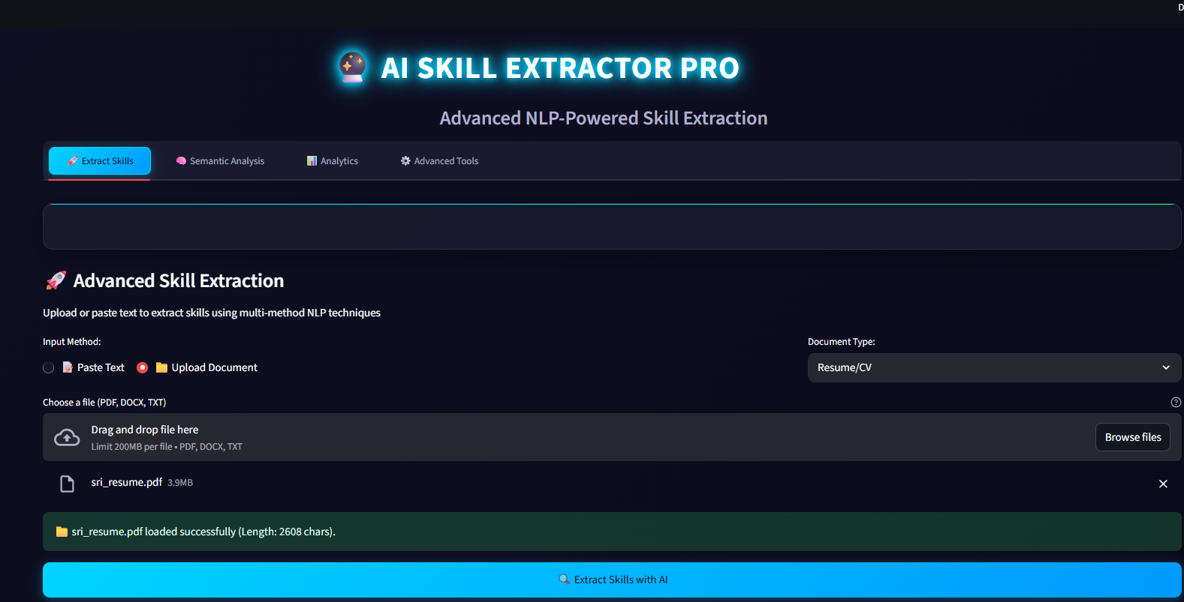
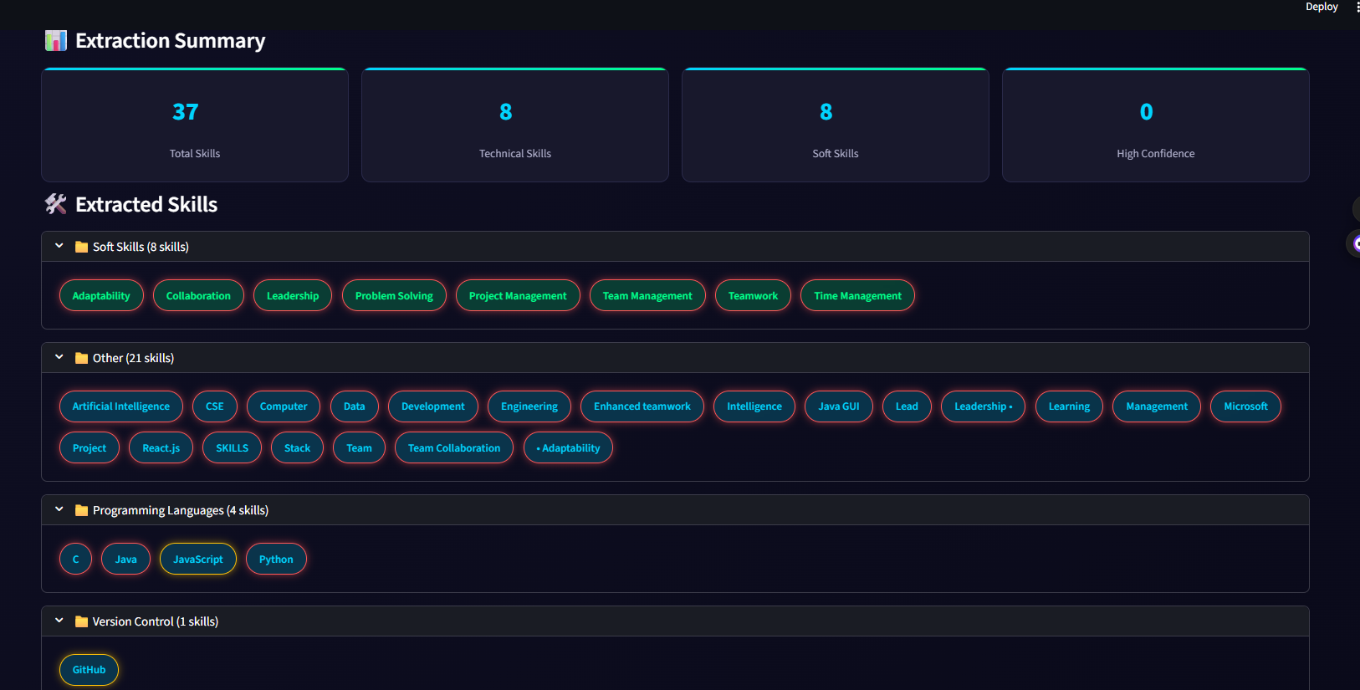

Slide 10
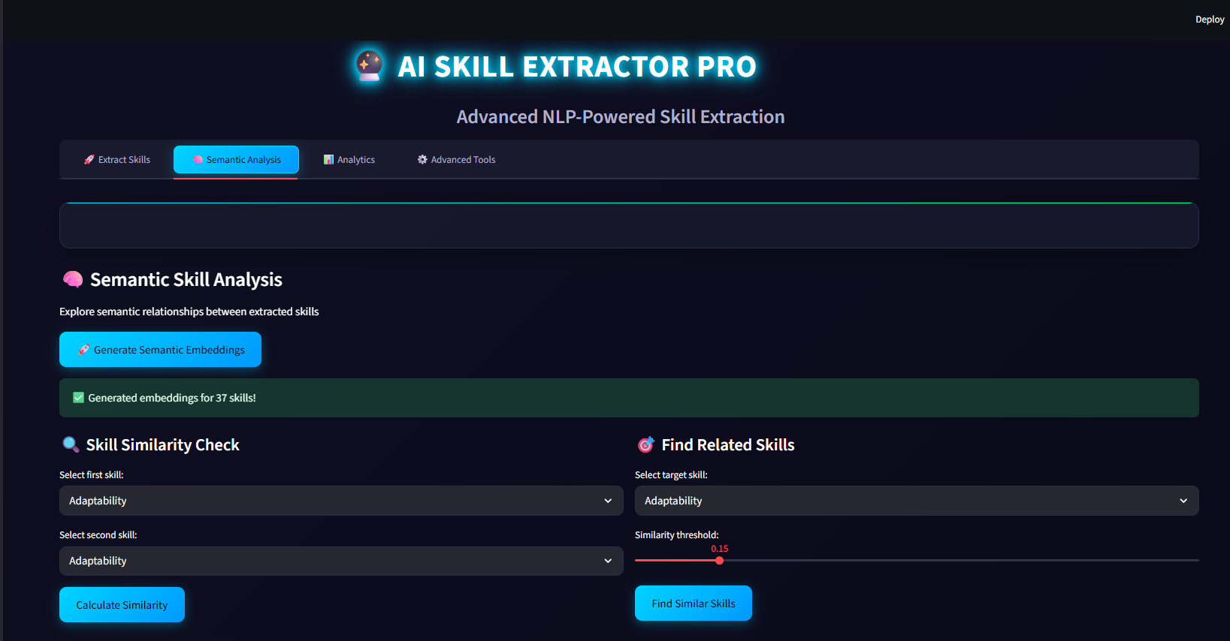
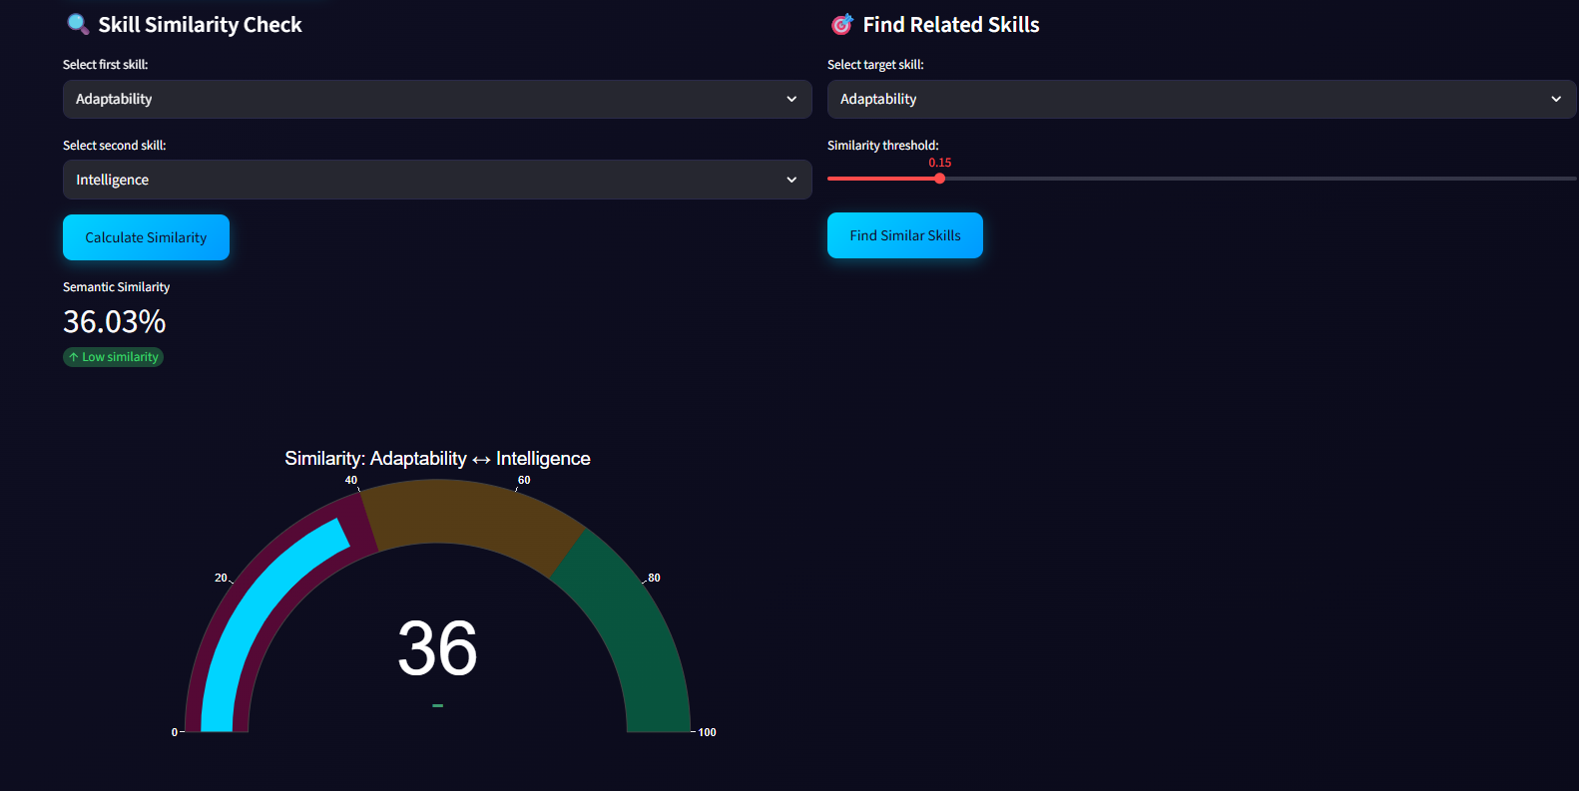

Slide 11
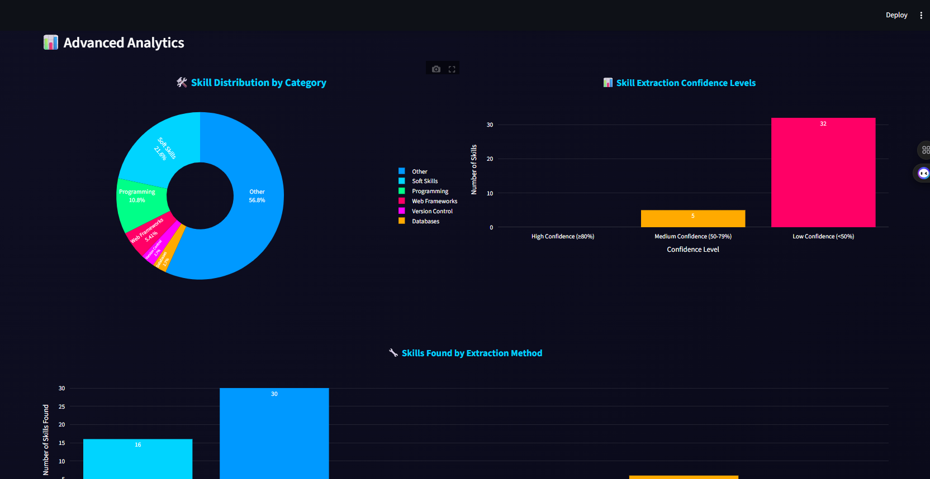
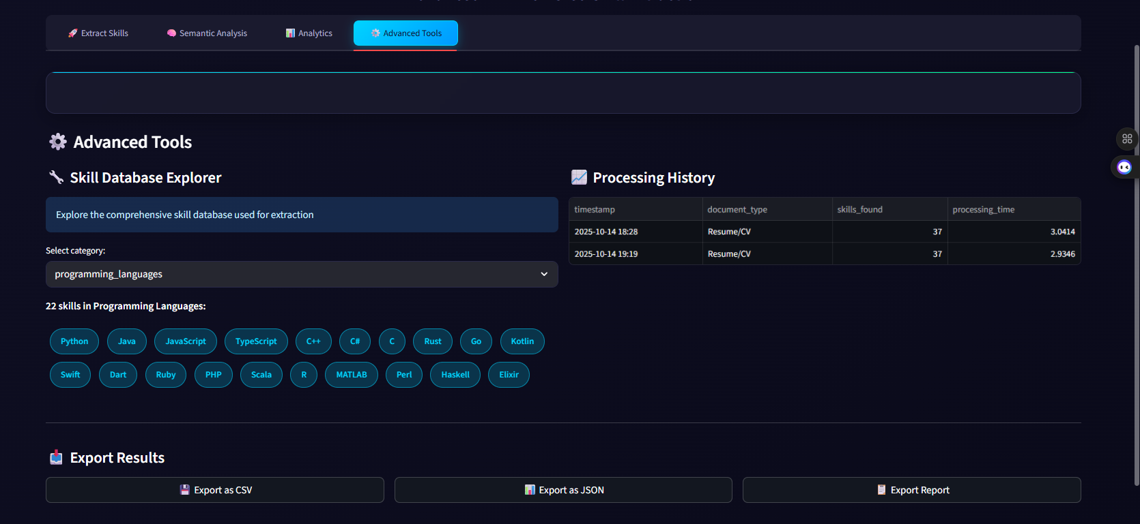

Slide 12

7. Demo – Skill Extraction with Confidence Scores
What the system gives back:
A list of all skills found in the document.
Each skill is tagged with a confidence score and color.
Skills grouped by categories (Tech, Soft Skills, Tools, etc.)
Visual Power:
Green = high confidence,
Blue = related skill via AI,
Gray/Yellow = lower confidence.
“A recruiter or ATS system can instantly spot the most relevant skills.”

Slide 13


8.Semantic Relationships & Skill Intelligence
Use Case Example:
1
Show how “Python” and “Django” have a similarity score of 85%.
2
Even if Django wasn't written exactly, AI picked it up from context.
Bonus:
Can also spot emerging fields like “LLMs”, “LangChain”, “Web3”, etc.
“This is where we go beyond just matching – now we understand skill meaning.”

Slide 14



9. Conclusion & What’s Next
What we achieved:
✅ Built a smart AI engine to extract skills from resumes.
✅ Used semantic analysis, not just keywords.
✅ Gave confidence scores to every skill.
✅ Ready for real-world recruiting scenarios.
Next Steps (Milestone 3):
Use this engine to
• Build Skill Gap Analyzer (compare job vs resume).
• Do candidate-job matching.
• Build search filters based on skill strength.

Slide 15

Thank You

